Slide 1
Understanding Confidence Intervals

Slide 2
Confidence Intervals:
Confidence Interval (CI) is essential in statistics and very important for data scientists.
As it sounds, the confidence interval is a range of values. In the ideal condition, it should contain the best estimate of a statistical parameter. It is expressed as a percentage.
95% confidence interval is the most common.
You can use other values like 97%, 90%, 75%, or even 99% confidence interval if your research demands.
Let’s understand it by an example:

Slide 3
Example:
“In a sample of 659 parents with toddlers, about 85%, stated they use a car seat for all travel with their toddler. From these results, a 95% confidence interval was provided, going from about 82.3% up to 87.7%.”
This statement means, we are 95% certain that the population proportion who use a car seat for all travel with their toddler will fall between 82.3% and 87.7%.
If we take a different sample or a subsample of these 659 people, 95% of the time, the percentage of the population who use a car seat in all travel with their toddlers will be in between 82.3% and 87.7%.
* Remember, 95% confidence interval does not mean 95% probability

Slide 4
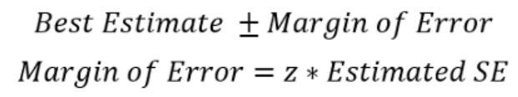
How to Calculate the Confidence Interval:
The calculation of the confidence interval involves the best estimate which is obtained by the sample and a margin of error. So, we take the best estimate and add a margin of error to it. Here is the formula for the confidence interval and the margin of error:
SE is the standard error.
Normally, CI is calculated for two statistical parameters:
The proportion and the mean.

Slide 5
Combining these two formulas above, we can elaborate the formula for CI as follows:
Population proportion or the mean is calculated from the sample.
In the example of “the parents with toddlers”, the best estimate or the population proportion of parents that uses car seats in all travel with their toddlers is 85%. So, the best estimate (population proportion) is 85.
z-score is fixed for the confidence level (CL).
A z-score for a 95% confidence interval for a large enough sample size(30 or more) is 1.96.

Slide 6
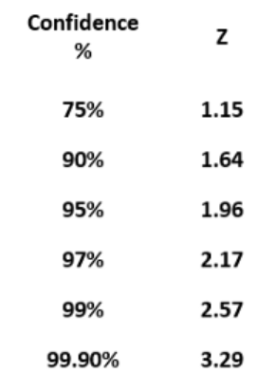
Here are the z-scores for some commonly used confidence levels:

Slide 7
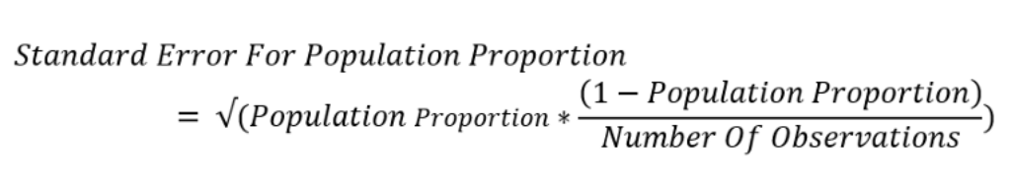
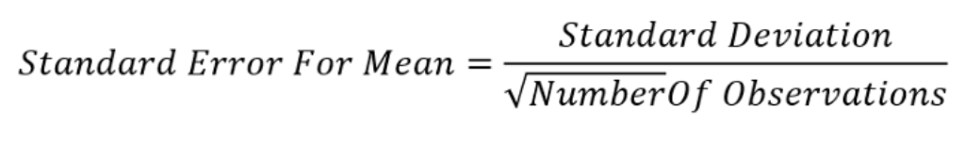
The method to calculate the standard error is different for population proportion and mean.
The formula to calculate standard error of population proportion is:
he formula to calculate the standard error of the sample mean is:

Slide 8

As per the statement, the population proportion that uses a car seat for all travel with their toddlers is 85%.
So, this is our best estimate. We need to add the margin of error to it.
To calculate the margin of error we need the z-score and the standard error.
I am going to calculate a 95% CI.
The z-score should be 1.96 and I already mentioned the formula of standard error for the population proportion.
Plugging in all the values:
The confidence interval is 82.3% and 87.7% as we saw in the statement before.

Slide 9
Assumptions for a Single Population Proportion Confidence Interval

Slide 10
When constructing confidence intervals the assumptions and conditions of the central limit theorem must be met in order to use the normal model.
Randomization Condition: The data must be sampled randomly. Is one of the good sampling methodologies discussed in the Sampling and Data chapter being used?
Independence Assumption: The sample values must be independent of each other. This means that the occurrence of one event has no influence on the next event. Usually, if we know that people or items were selected randomly we can assume that the independence assumption is met.

Slide 11
10% Condition: When the sample is drawn without replacement (usually the case), the sample size, n, should be no more than 10% of the population.
Sample Size Condition: The sample size must be sufficiently large. Although the Central Limit Theorem tells us that we can use a Normal model to think about the behavior of sample means when the sample size is large enough, it does not tell us how large that should be.
If the population is very skewed, you will need a pretty large sample size to use the CLT.
however if the population is unimodal and symmetric, even small samples are ok. So think about your sample size in terms of what you know about the population and decide whether the sample is large enough. In general a sample size of 30 is considered sufficient.

Slide 12
Assumptions(Continued…………):
When working with numerical data and σ is unknown the assumptions of randomization, independence and the 10% condition must be met.
In addition, with small sample sizes we cannot assume that that data follows a normal distribution so we need to check the nearly normal condition.
To check the nearly normal condition start by making a histogram or stemplot of the data, it is a good idea to make an outlier boxplot, too.
If the sample is small, less than 15 then the data must be normally distributed.

Slide 13
If the sample size is moderate, between 15 and 40, then a little skewing in the data will can be tolerated.
With large sample sizes, more than 40, we are concerned about multiple peaks (modes) in the data and outliers.
The data might not be approximately normal with either of these conditions and you may want to run the test both with and without the outliers to determine the extent of their effect.
If there are multiple modes in the data if could be that there are two groups in the data that need to be separated

Slide 14
When working with binomial or categorical data the assumptions of randomization, independence and the 10% condition must be met.
In addition, a new assumption, the success/ failure condition, must be checked.
When working with proportions we need to be especially concerned about sample size when the proportion is close to zero or one.
To check that the sample size is large enough calculate the success by multiplying the sample percentage by the sample size and calculate failure by multiplying one minus the sample percentage by the sample size.
If both of these products are larger than ten then the condition is met.

Slide 15
Interpretations & Assumptions for Two Population Proportion Intervals

Slide 16
We need to assume that we have two independent random samples.
We also need large enough sample sizes to assume that the distribution of our estimate is normal.
That is, we need n1p̂1, n1(1-p̂1), n2p̂2, and n2(1-p̂2) to all be at least 10.

Slide 17
Confidence intervals in Python

Slide 18
The tools we use for this exercise are:
Numpy Library
Pandas Library
Statsmodels Library
Jupyter Notebook environment
If you install an anaconda package, you will get a Jupyter Notebook and the other tools as well.

Slide 19
CI for the population Proportion in Python:
We will use the Heart dataset from Kaggle.
Please click on the following link to download the dataset.
https://www.kaggle.com/johnsmith88/heart-disease-dataset
First, we have to import the packages and the dataset:
import pandas as pd import numpy as np df = pd.read_csv('Heart.csv') df

Slide 20
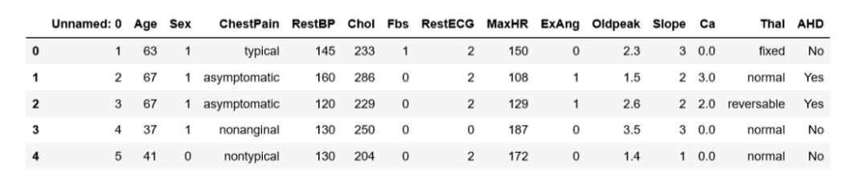
The last column of the data is ‘AHD’.
It says if a person has heart disease or not. In the beginning, we have a ‘Sex’ column as well.

Slide 21
We are going to construct a CI for the female population proportion that has heart disease:
First, replace 1 and 0 with ‘Male’ and ‘Female’ in a new column ‘Sex1’.
df['Sex1'] = df.Sex.replace({1: "Male", 0: "Female"})
We do not need all the columns in the dataset.
We will only use the ‘AHD’ column as that contains if a person has heart disease or not and the Sex1 column we just created.
Make a DataFrame with only these two columns and drop all the null values.
dx = df[["AHD", "Sex1"]].dropna()

Slide 22
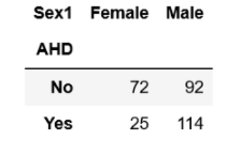
Here is the output table:
The number of females who have heart disease is 25. Calculate the female population proportion with heart disease.
p_fm = 25/(72+25)
The ‘p_fm’ is 0.26. The size of the female population:
n = 72+25

Slide 23
The size of the female population is 97. Calculate the standard error:
se_female = np.sqrt(p_fm * (1 - p_fm) / n)
The standard error is 0.044.
Now construct the CI using the formulas above. The z-score is 1.96 for a 95% confidence interval:
z_score = 1.96 lcb = p_fm - z_score* se_female #lower limit of the CI ucb = p_fm + z_score* se_female #upper limit of the CI
The confidence interval is 0.17 and 0.344.

